Slide 1
Chapter 2

Slide 2
Objectives

Slide 3
Objectives (cont.)

Slide 4
Objectives (cont.)

Slide 5
Objectives (cont.)

Slide 6
A sample application

Slide 7
A sample application (cont.)

Slide 8
A block comment

Slide 9
Valid identifiers

Slide 10
Keywords

Slide 11
The syntax for declaring a class

Slide 12
The syntax for declaring a main method

Slide 13
A public class that contains a main() method

Slide 14
The rules for naming a class

Slide 15
Two of the eight primitive data types

Slide 16
How to declare a variable and assign a value in two statements

Slide 17
How to declare a variable and assign a value in one statement

Slide 18
An example that uses assignment statements

Slide 19
Naming recommendations for variables

Slide 20
The basic operators for arithmetic expressions

Slide 21
Statements that use simple arithmetic expressions

Slide 22
Statements that increment a counter variable

Slide 23
The syntax for declaring and initializing a string variable

Slide 24
How to join strings

Slide 25
How to append one string to another with the + operator

Slide 26
Common escape sequences

Slide 27
A string with a new line

Slide 28
A string with quotation marks

Slide 29
Common packages

Slide 30
How to import a single class from a package

Slide 31
How to use the Scanner class to create an object

Slide 32
How to create an object from a class

Slide 33
How to call a static method from a class

Slide 34
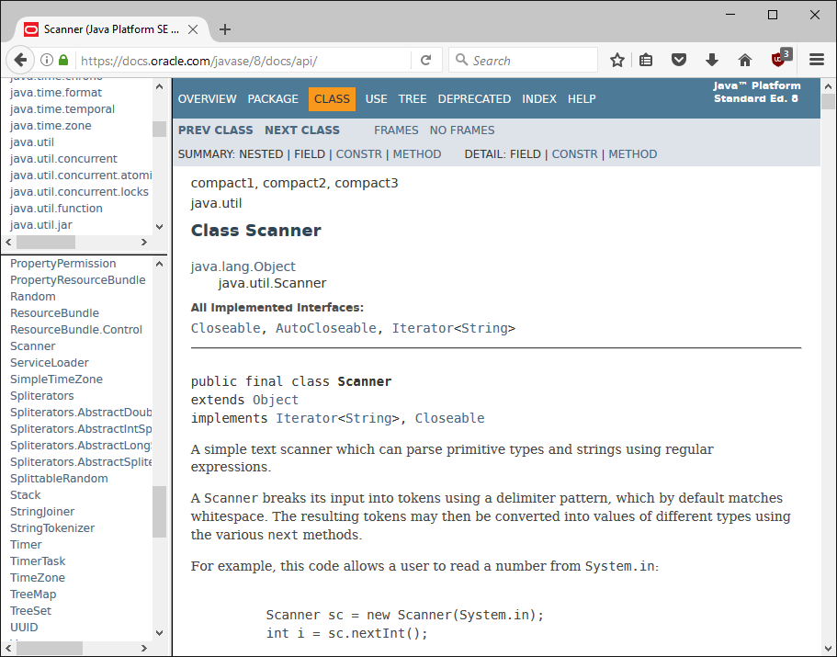
The documentation for the Scanner class

Slide 35
Two methods of the System.out object

Slide 36
An application that prints data to the console

Slide 37
An application that prints data to the console (cont.)

Slide 38
The console

Slide 39
The Scanner class

Slide 40
Common methods of a Scanner object

Slide 41
Code that gets three values from the user

Slide 42
The console after the program finishes

Slide 43
Code that reads three values from one line

Slide 44
Relational operators

Slide 45
Examples of Boolean expressions

Slide 46
Two methods of the String class

Slide 47
The syntax of the if/else statement

Slide 48
If statements without else if or else clauses

Slide 49
An if statement with an else clause

Slide 50
The syntax of the while loop

Slide 51
A loop that continues while choice is “y” or “Y”

Slide 52
A loop that calculates the sum of the numbers 1 through 4

Slide 53
The console for the Invoice application

Slide 54
The code for the Invoice application

Slide 55
The code for the Invoice application (cont.)

Slide 56
The code for the Invoice application (cont.)

Slide 57
The console for the Test Score application

Slide 58
The code for the Test Score application

Slide 59
The code for the Test Score application (cont.)

Slide 60
The code for the Test Score application (cont.)

Slide 61
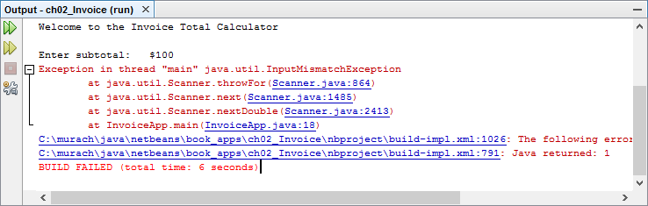
A runtime error that occurred while testing the Invoice application

Slide 62
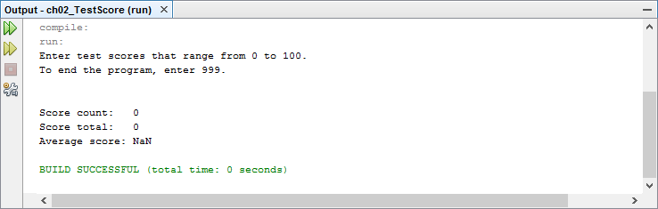
Incorrect output produced by the Test Score application

Slide 63
Debugging tips

